Slide 1
CS 4476 Project 3
Ashwin Rathie
Ashwin.rathie@gatech.edu
903281887

Slide 2
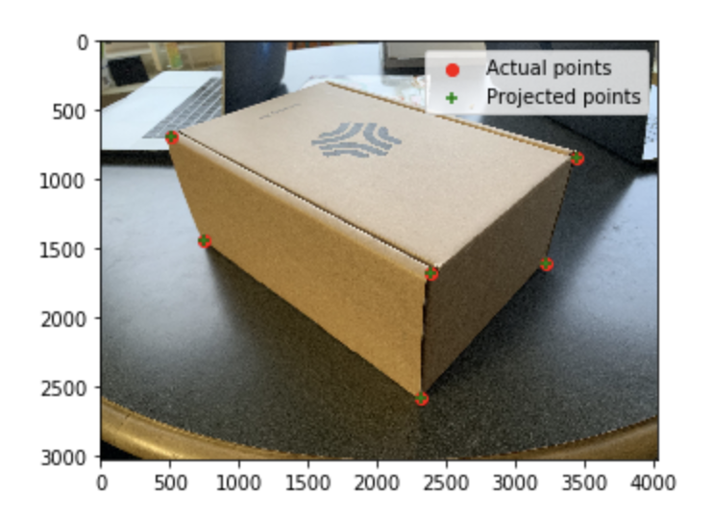
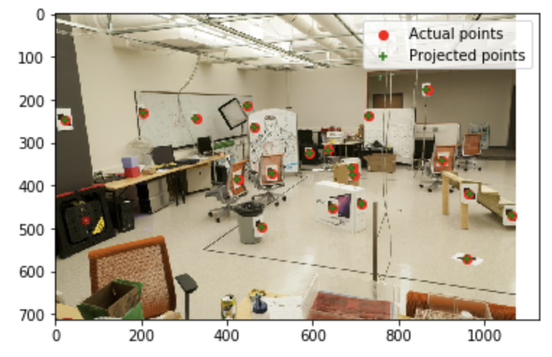
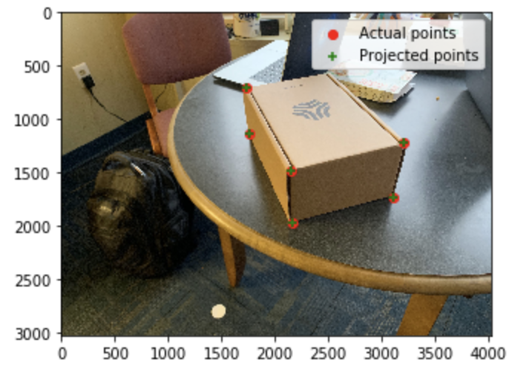
Part 1: Projection Matrix

Slide 3
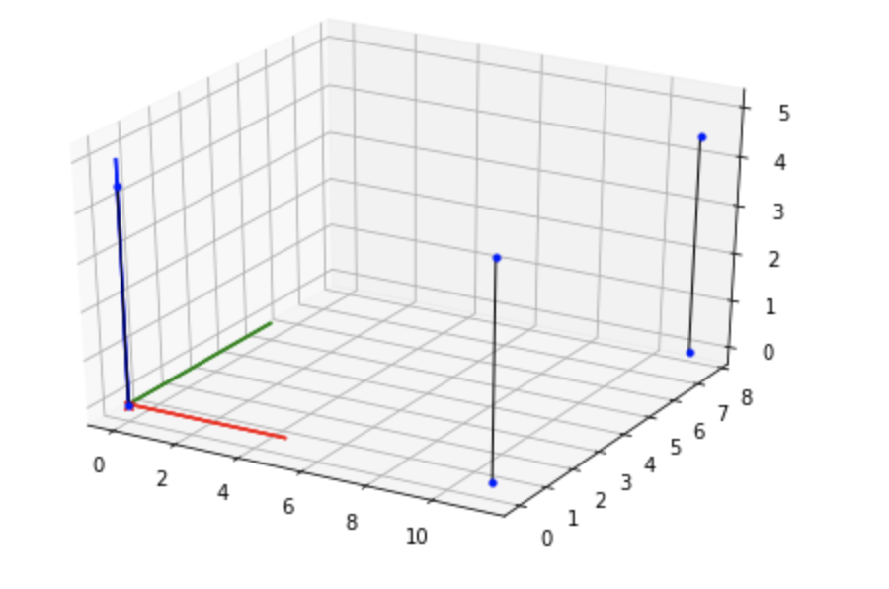
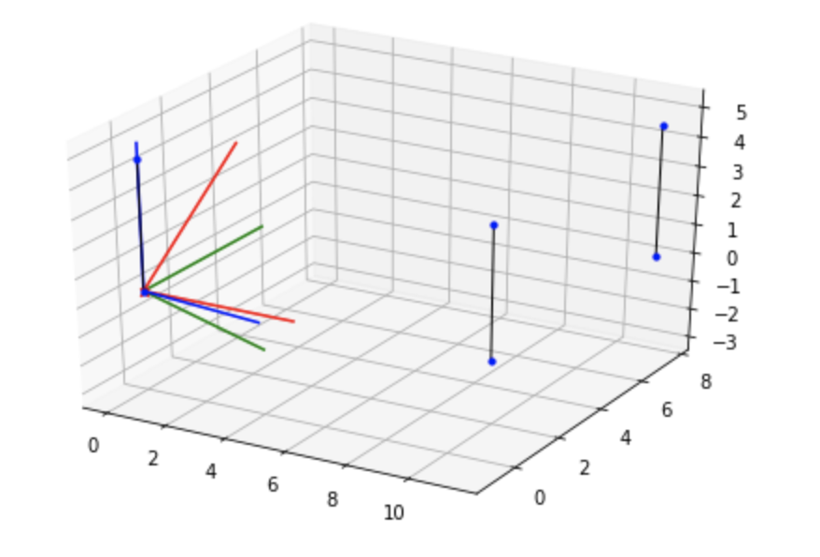
Part 1: Projection Matrix

Slide 4
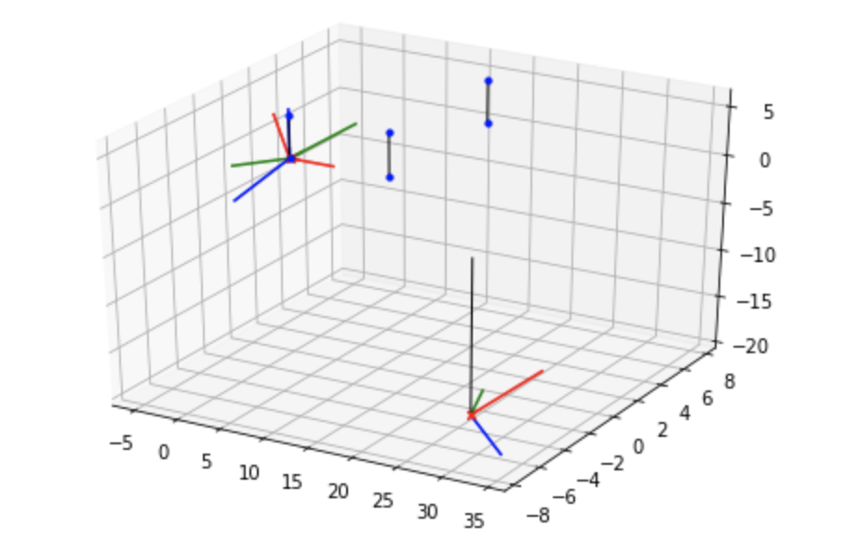
Part 1: Projection Matrix
<insert visualization of both camera poses here>

Slide 5
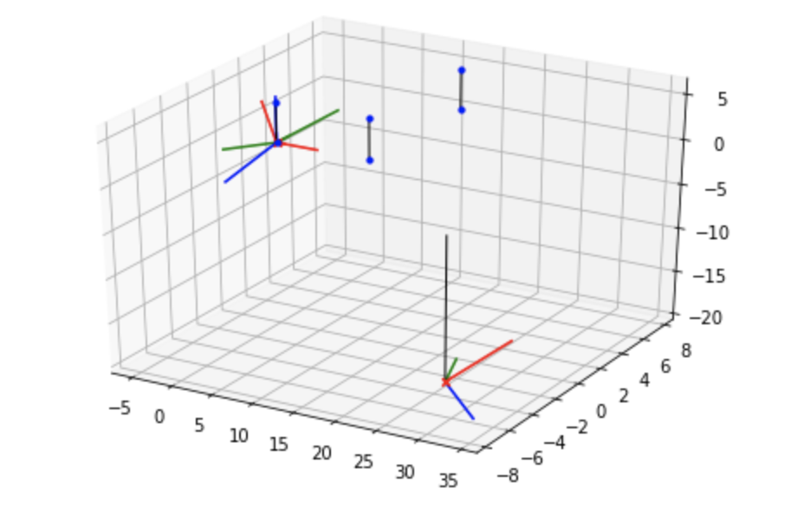
Part 1: Projection Matrix
<your answers and images for the report questions>
Changing any of the coordinates of the camera coordinates would result in the a change in the opposite direction (i.e. increasing camera coordinates will result in decrease of the projected coordinates) of the projected points.
I increased the camera coordinates by 3 in each
coordinate and the resulting projection matrix
shows a decrease by 3 in each coordinate. The
results are as expected

Slide 6
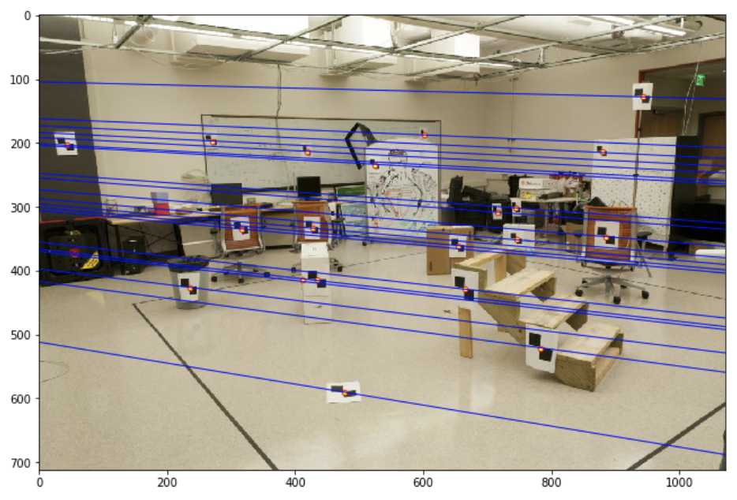
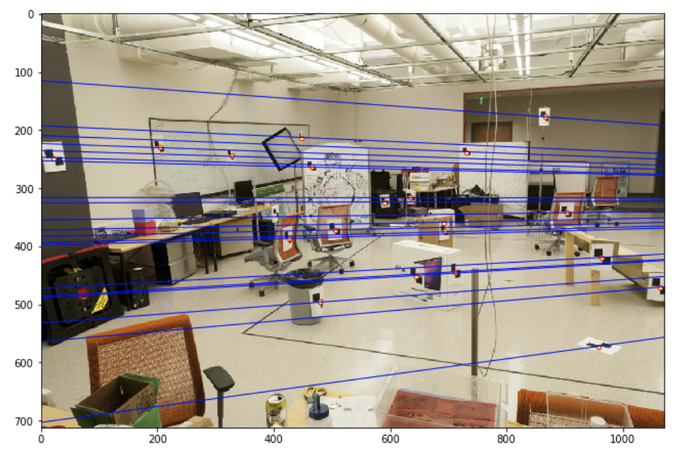
Part 2: Fundamental Matrix Estimation
Room: Left Image with Epipolar Lines
<insert your image here>
Room: Right Image with Epipolar Lines
<insert your image here>

Slide 7
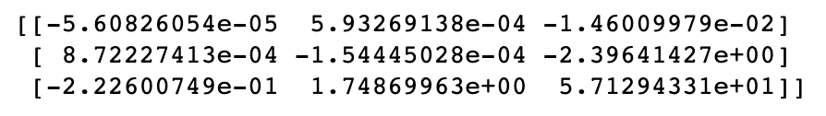
Part 2: Fundamental Matrix Estimation
Fundamental Matrix Estimation Result:

Slide 8
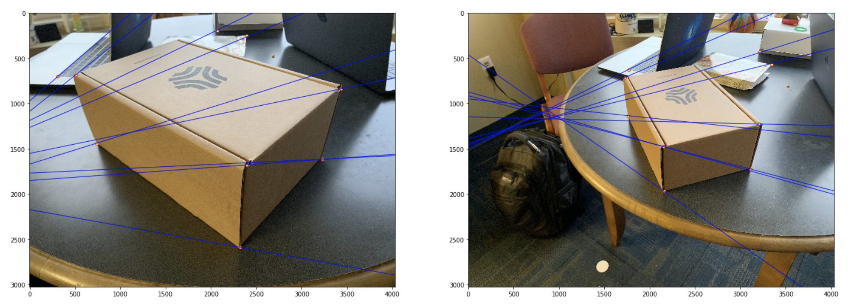
Part 2: Fundamental Matrix Estimation: Your Images
Your Image: Left Image with Epipolar Lines
<insert your image here>
Your Image: Right Image with Epipolar Lines
<insert your image here>

Slide 9
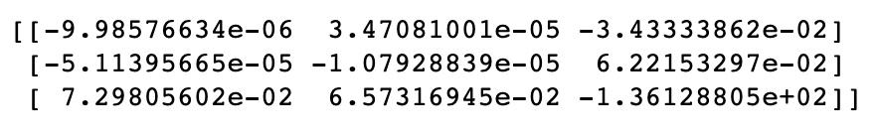
Part 2: Fundamental Matrix Estimation: Your Image
Fundamental Matrix Estimation Result:

Slide 10
Part 2: Reflection Questions
1. Rotating or zooming the same image essentially does not add any new information and therefore does not help with triangulation. The lines and edges are all the same after rotation and scaling, but changing the actual location and angle of the image gives new perspective.
2. The fundamental matrix relates the frame of one image to the frame of the other image. This is visualized by the epipolar lines in the other image, which emanate out from the point where the camera that took the other image was. Therefore, point in image 1 will fall on the epipolar lines in image 2 because the epipolar lines in image 2 emanate out from the camera that took image 1.
3. The epipoles will appear on the image at the point where the other camera lens is and the epipoalr lines will all converge at the epipoles (the camera lens of the other camera). This is because when the camera centers are within the images, the convergence point for the epipolar lines is also in the frame.
4. When the epipolar lines are perfectly horizontal, and therefore parallel, it mean the epipole (where the lines intersect) are infinitely far apart. Therefore, the cameras are infinitely far apart on the horizontal axis.
5. The fundamental matrix equation is x^T*F*x = 0, showing that scaling F does not invalidate the formula. Scaling the fundamental matrix in the homogenous form does not change the result.
6. The fundamental matrix is 3x3 and maps points to lines. It has one free axis, meaning that not all of the columns are linearly independent, only 2 of them, making the rank 2.

Slide 11
Part 2: Extra Credit: Fundamental Matrix Song
Reflect on the Fundamental Matrix Song
Link here: https://www.youtube.com/watch?v=DgGV3l82NTk
Computer scientists should not sing, generally
The fundamental matrix has a rank deficiency (rank 2) and 7 degrees of freedom. The fundamental matrix equation always equals 0.
Trying to estimate with a coplanar set of points will result in a degenerate set.

Slide 12
Part 3: RANSAC Iterations Questions
Delete the questions and type your answers to the three RANSAC Iterations questions from the jupyter notebook below:
9 point correspondences per iteration. p = 0.90, k = 9, P = 0.999. Num_rounds > log(1-P)/ log(1-p^k). Num_roiunds = 15 iterations.
Same equation as above but with k = 18. Num_rounds = 43
For 9 point correspondences, same equation as part 1 with p = 0.7, so Num_rounds = 168. For 18 points, same equation as part 2 with p = 0.7, sp Num_rounds = 4239

Slide 13
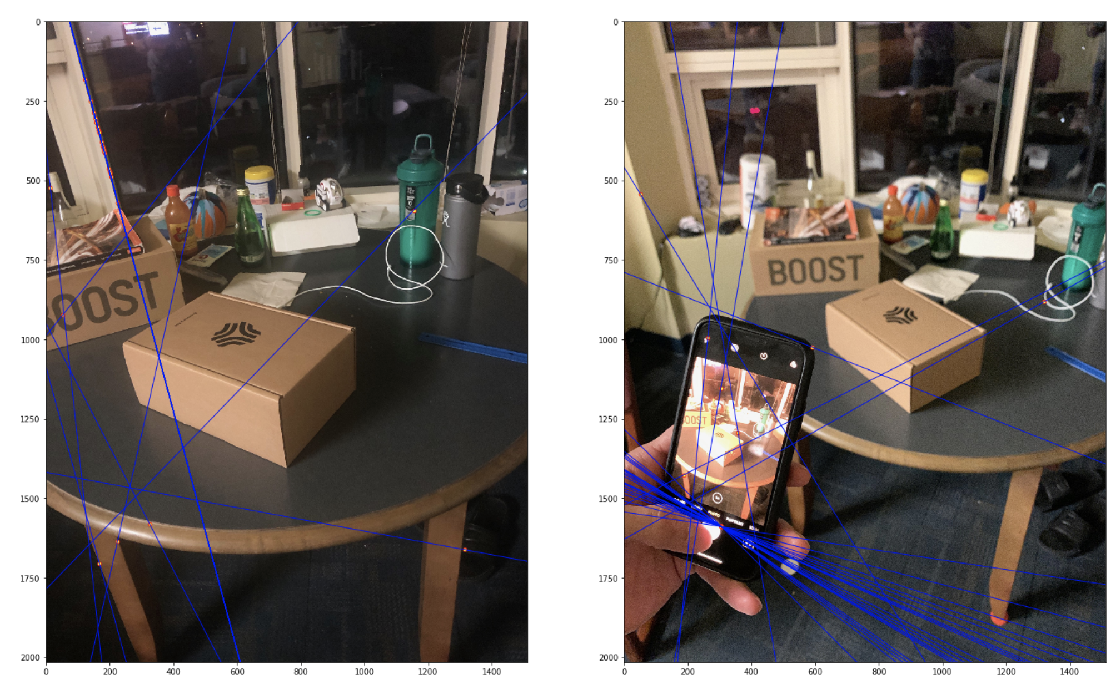
Part 3: RANSAC Implementation

Slide 14
Part 3: RANSAC Extra Credit!!!
Paste a second image pair that you created demonstrating the use of your RANSAC algorithm in a different environment, and reflect on how your code relates to the RANSAC song. https://www.youtube.com/watch?v=1YNjMxxXO-E

Slide 15
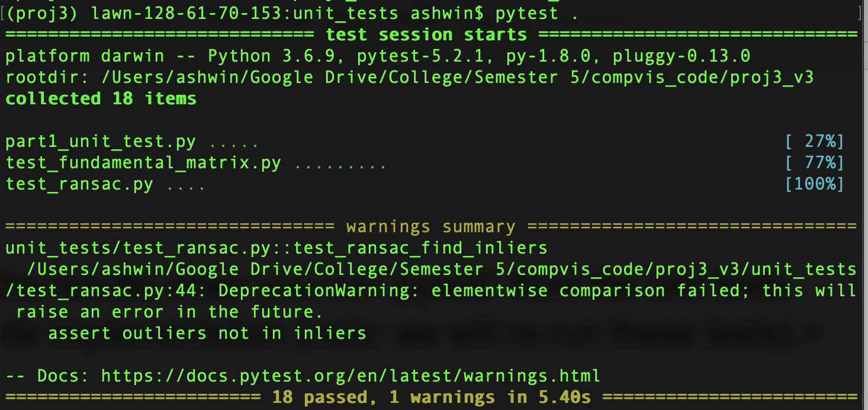
Tests
*Note: I ran “cd unit_tests” and then ran “pytest .”

Slide 16
Conclusions
I always wondered how the 3D reconstruction I had seen from, honestly, spy movies worked but also kind of assumed it was science fiction. Then, Professor Dellaert showed us the city reconstruction project his former colleague worked on and it was really fascinating. The concept of triangulation to infer 3D relationships from 2D images made intuitive sense to me but diving into the nitty gritty math of it all was eye-opening. I learned how we relate the points in on 2D image to the frame of another image, creating a mathematical representation of this relationship. Challenges I ran into during this project included getting the epipolar lines to converge as neatly as I had seen in class and in examples.

Slide 17
Code results (do not modify this slide!)
Part 1
Part 2
Part 3

